Slide 1
Regularization in Machine Learning
By- Brajraj
Date- 04-Jan-2021

Slide 2
Agenda:
Overfitting (review)
Overfitting with linear models
Regularization of linear models
Regularized regression in scikit-learn
Comparing regularized linear models with unregularized linear models

Slide 3
1: Overfitting (review)
What is overfitting?
Building a model that matches the training data "too closely"
Learning from the noise in the data, rather than just the signal
How does overfitting occur?
Evaluating a model by testing it on the same data that was used to train it
Creating a model that is "too complex"
What is the impact of overfitting?
Model will do well on the training data, but won't generalize to out-of-sample data
Model will have low bias, but high variance

Slide 4
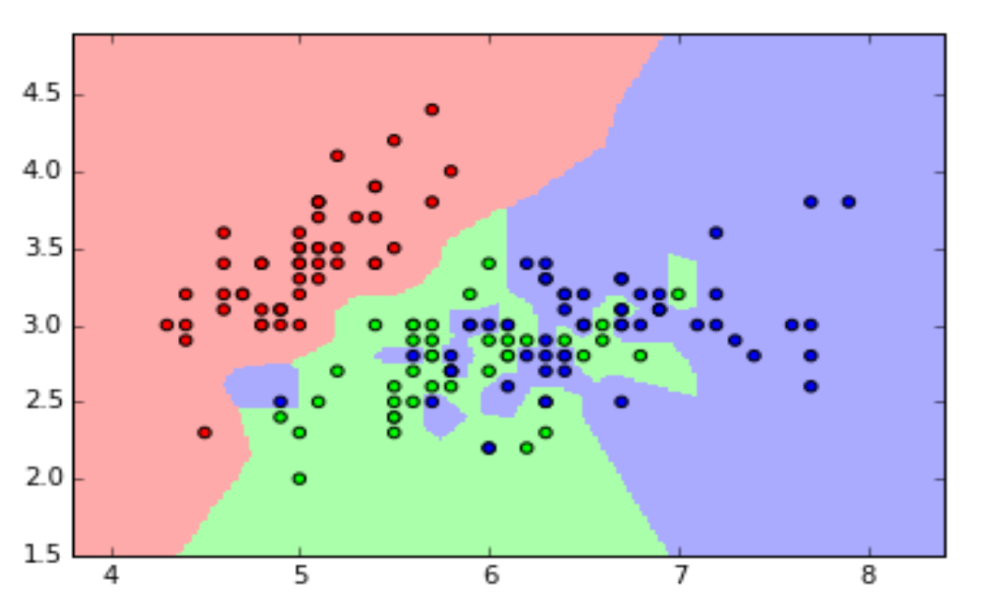
Overfitting with KNN

Slide 5
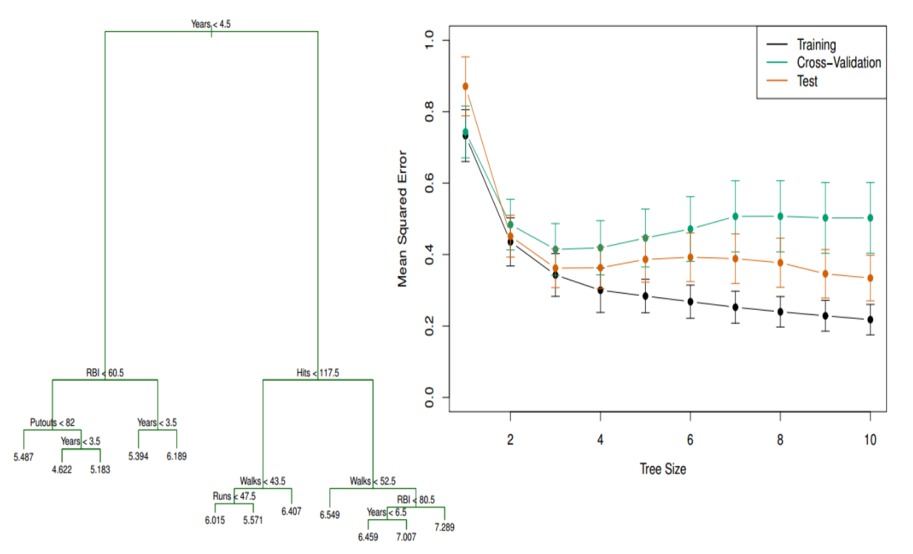
Overfitting with decision trees

Slide 6
2: Overfitting with linear models
What are the general characteristics of linear models?
Low model complexity
High bias, low variance
Does not tend to overfit
Nevertheless, overfitting can still occur with linear models if you allow them to have high variance. Here are some common causes:

Slide 7
Cause 1: Irrelevant features
Linear models can overfit if you include "irrelevant features", meaning features that are unrelated to the response. Why?
Because it will learn a coefficient for every feature you include in the model, regardless of whether that feature has the signal or the noise.
This is especially a problem when p (number of features) is close to n (number of observations), because that model will naturally have high variance.

Slide 8
Cause 2: Correlated features
Linear models can overfit if the included features are highly correlated with one another. Why?
“..coefficient estimates for Ordinary Least Squares rely on the independence of the model terms. When terms are correlated and the columns of the design matrix X have an approximate linear dependence, the design matrix becomes close to singular and as a result, the least-squares estimate becomes highly sensitive to random errors in the observed response, producing a large variance” from scikit-learn documentation

Slide 9
Cause 3: Large coefficients
Linear models can overfit if the coefficients (after feature standardization) are too large. Why?
Because the larger the absolute value of the coefficient, the more power it has to change the predicted response, resulting in a higher variance

Slide 10
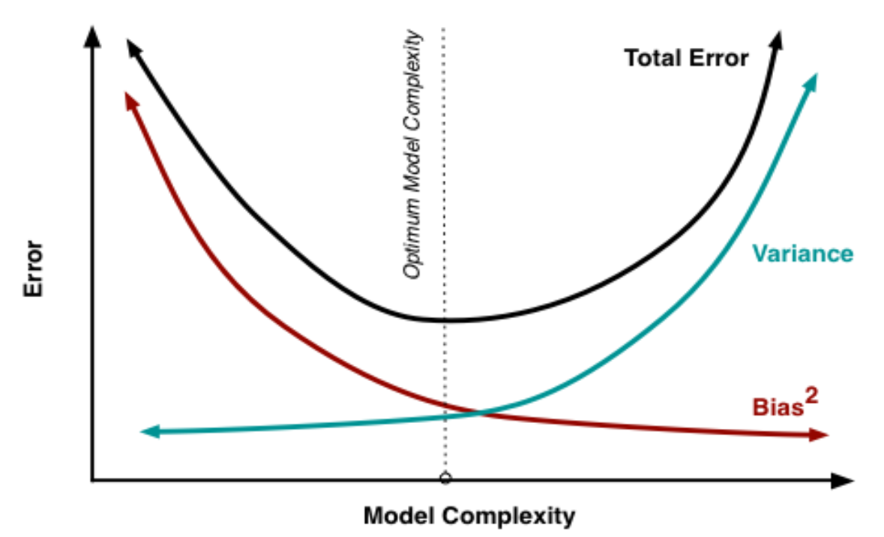
3: Regularization of linear models
Regularization is a method for "constraining" or "regularizing" the size of the coefficients, thus "shrinking" them towards zero.
It reduces model variance and thus minimizes overfitting.
If the model is too complex, it tends to reduce variance more than it increases bias, resulting in a model that is more likely to generalize.
Our goal is to locate the optimum model complexity, and thus regularization is useful when we believe our model is too complex.

Slide 11
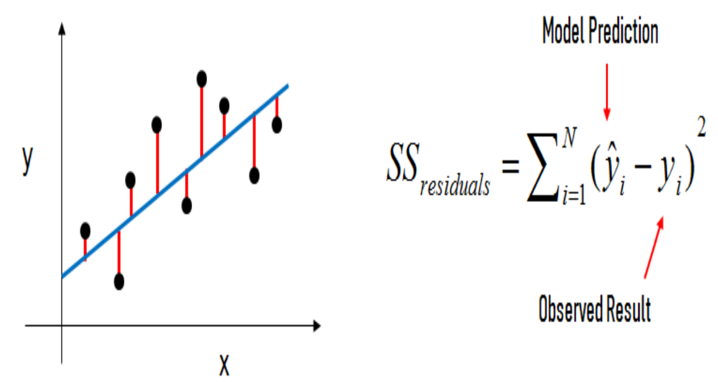
How does regularization work?
For a normal linear regression model, we estimate the coefficients using the least squares criterion, which minimizes the residual sum of squares (RSS):

Slide 12
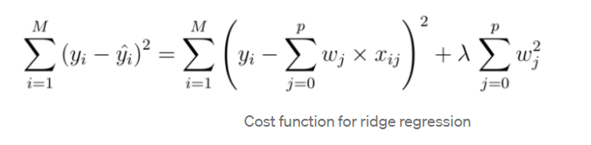
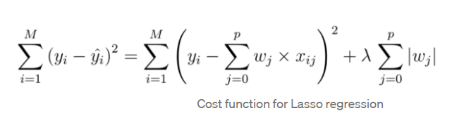
How does regularization work?
For a regularized linear regression model, we minimize the sum of RSS and a "penalty term" that penalizes coefficient size.
Ridge regression (or "L2 regularization") minimizes:
Lasso regression (or "L1 regularization") minimizes:
λ is tuning parameter.
A tiny λ imposes no penalty on the coefficient size, and is equivalent to a normal linear regression model.
Increasing the λ penalizes the coefficients and thus shrinks them.

Slide 13
Advice for applying regularization
Should features be standardized?
Yes, because otherwise, features would be penalized simply because of their scale.
Also, standardizing avoids penalizing the intercept, which wouldn't make intuitive sense.
How should you choose between Lasso regression and Ridge regression?
Lasso regression is preferred if we believe many features are irrelevant or if we prefer a sparse model.
If model performance is your primary concern, it is best to try both.
ElasticNet regression is a combination of lasso regression and ridge Regression.

Slide 14
6: Comparing regularized linear models with unregularized linear models
Advantages of regularized linear models:
Better performance
L1 regularization performs automatic feature selection
Useful for high-dimensional problems (p > n)
Disadvantages of regularized linear models:
Tuning is required
Feature scaling is recommended
Less interpretable (due to feature scaling)

